Slide 1
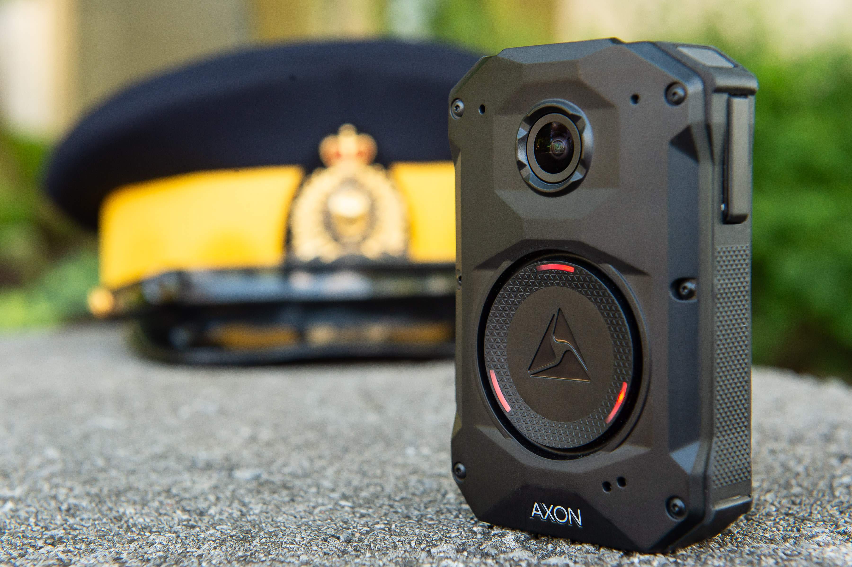
BODY-WORN CAMERA

Slide 2
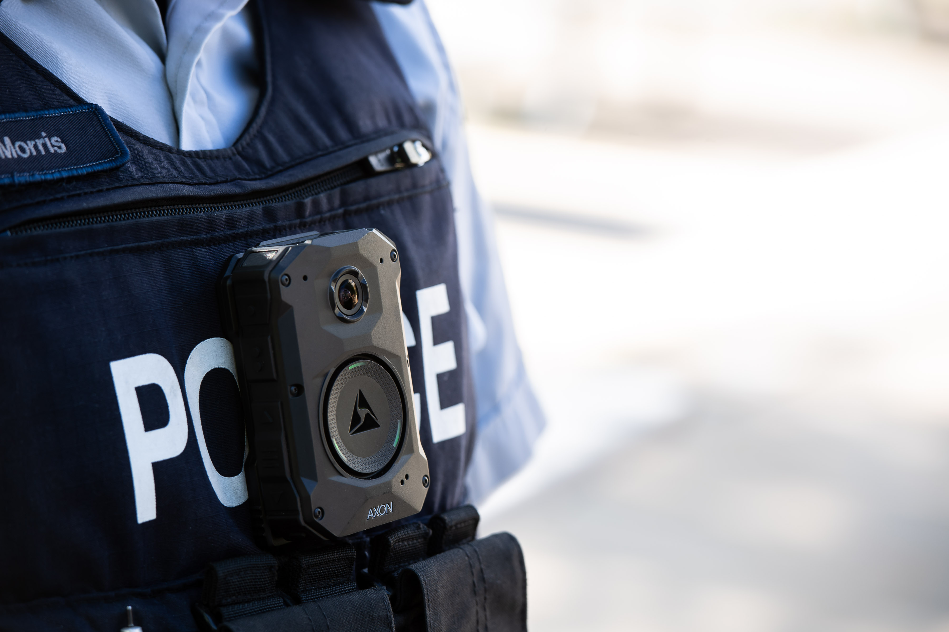
AGENDA
Project Overview
Expectations
Camera Use and Policy Overview
About the Digital Evidence Management System
BWC & DEMS Roadmap: Features & Functionalities
Community Request
Accessing Video
Deployment: National and Division
Feedback: What We Heard
Questions

Slide 3
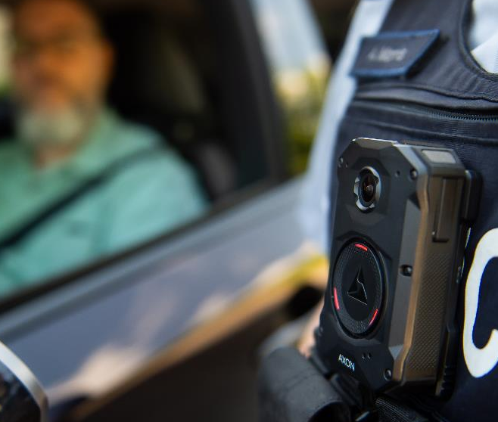
Project Overview
ENG: https://youtu.be/G670cilb0AA
Body-worn cameras will become a national standard for the general duty police officers of the RCMP.
10,000-15,000 body-worn cameras will be deployed to frontline members across Canada.
Supported by a pre-configured cloud-based digital evidence management system (software as a service)

Slide 4
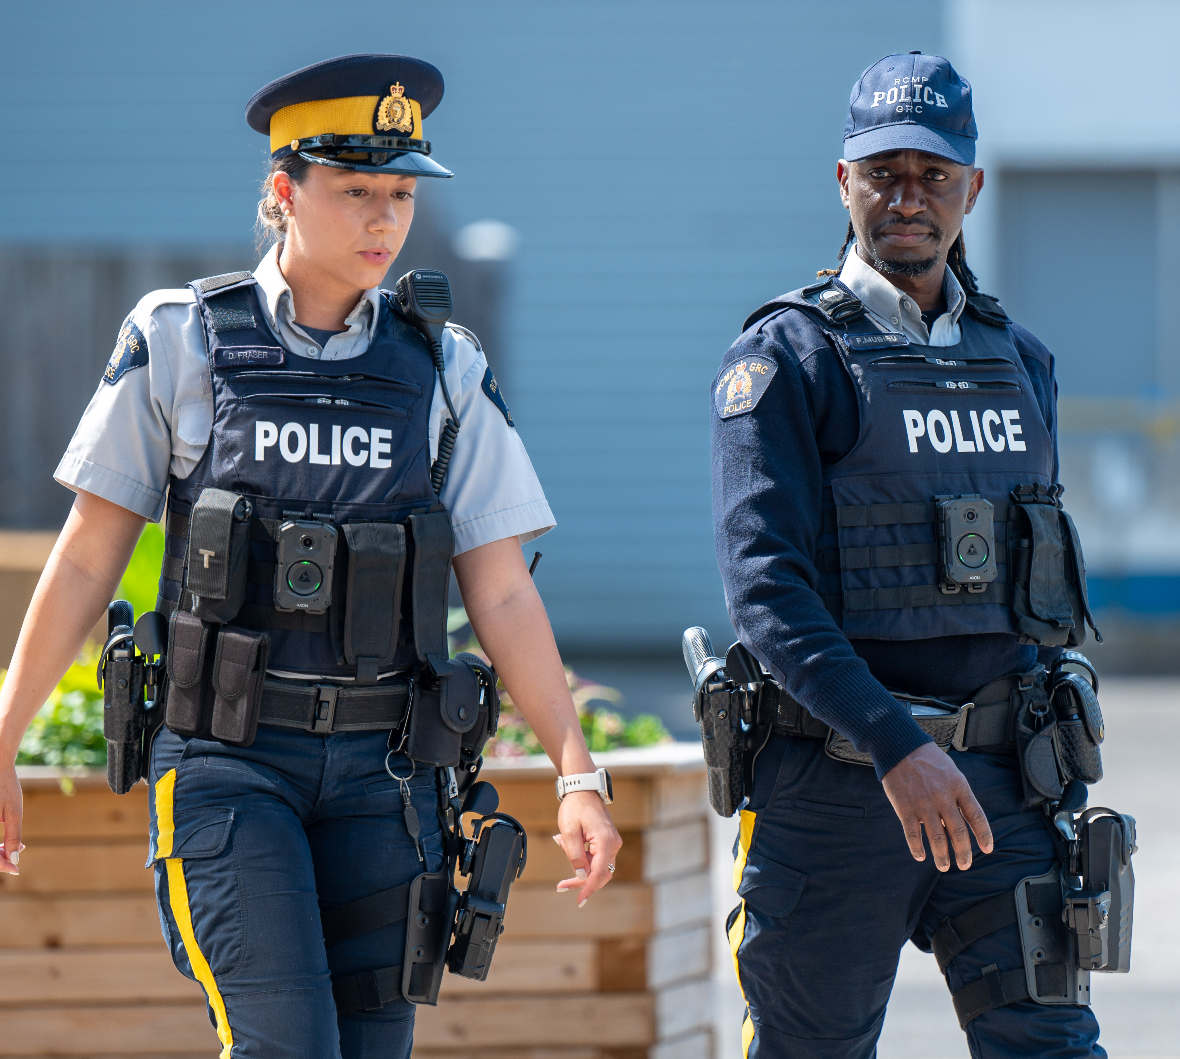
Expectations
Body-worn cameras (BWC) are intended to capture an accurate unbiased audio/video account of incidents involving police.
Once implemented, expect:
Greater accountability and public trust
Better interactions between the police and the public
Improved evidence gathering
Quicker resolutions of public complaints

Slide 5
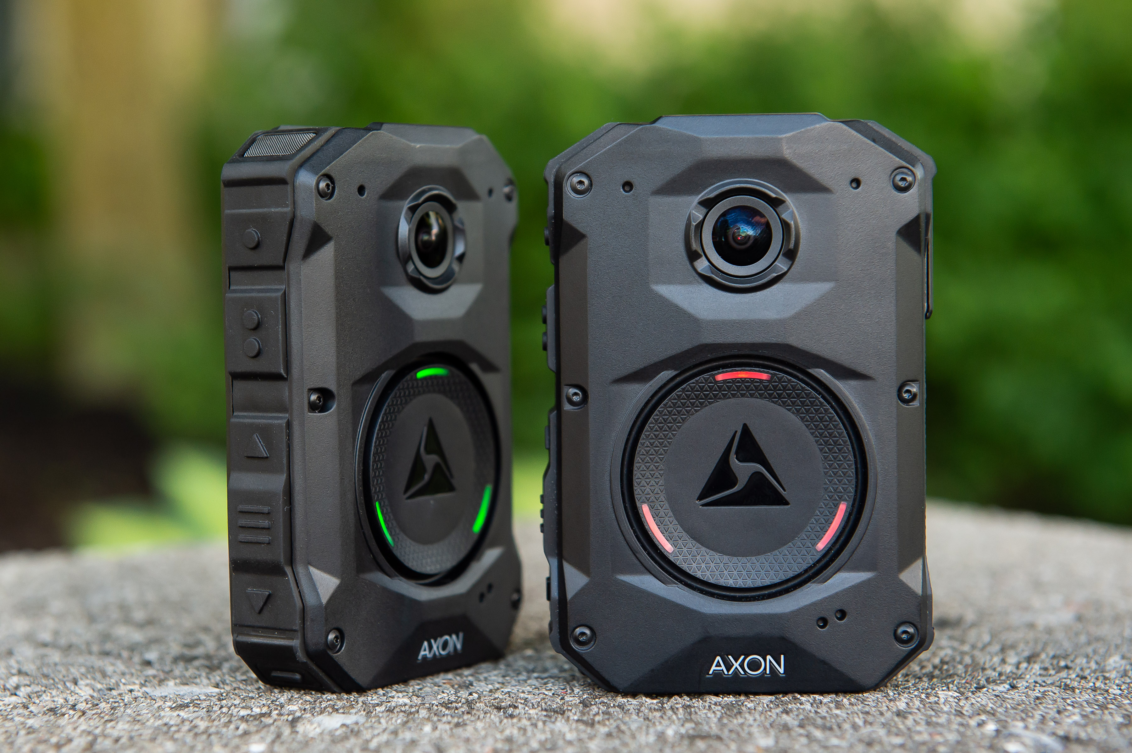
Lights turn RED when recording
Lights turn GREEN when in ‘ready mode’ buffering
Notes:
Each camera can store up to 60 hours of audio and video.
Battery life is estimated to be 13+ hours.

Slide 6
Policy Overview - Use of Body Worn Cameras
They will be used:
Not Intended for:
Prior to arriving at a call for service
When initiating contact with a member of the public for the purpose of investigation
To record information to support lawful execution of duties
24 hour recording
Surveillance or covert recording
When strip or body cavity searches are conducted
Areas with a high expectation of privacy unless there are exigent circumstances
BODY-WORN CAMERAS
Examples of use:
Examples of when camera can be turned off
Mental health calls
Interactions with people in crisis
Crimes in progress
Investigations
Public disorder
Intimate searches
Incidents of a sensitive nature
Investigative discussions/enquiries between police personnel
Formal statements

Slide 7
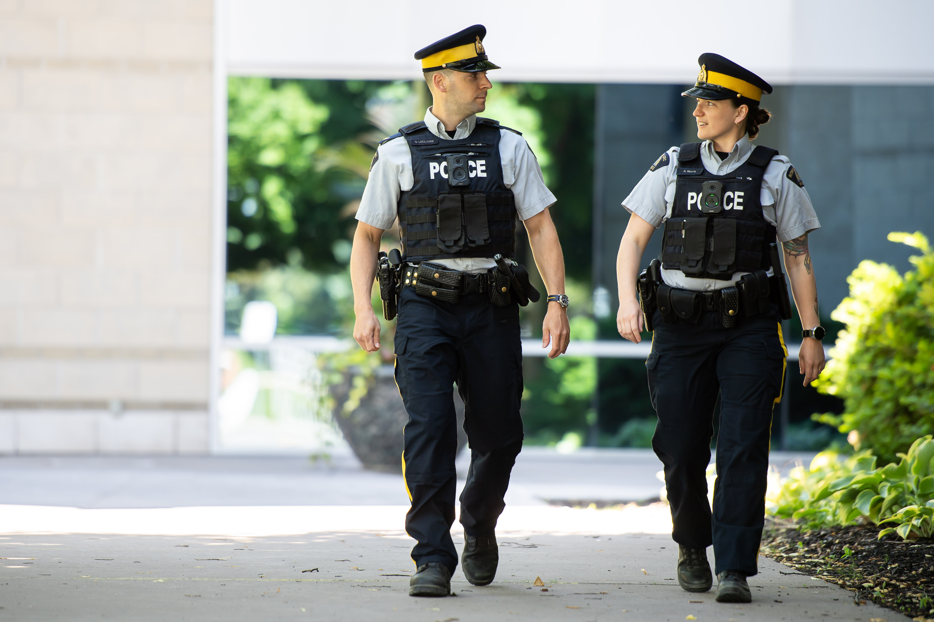
On Duty
Prior to arriving at a call for service or before exiting their vehicle, officer turns on their camera “Seat belt off. Camera on”
Whenever possible, the officer will advise a member of the public and first responders when the camera is recording

Slide 8
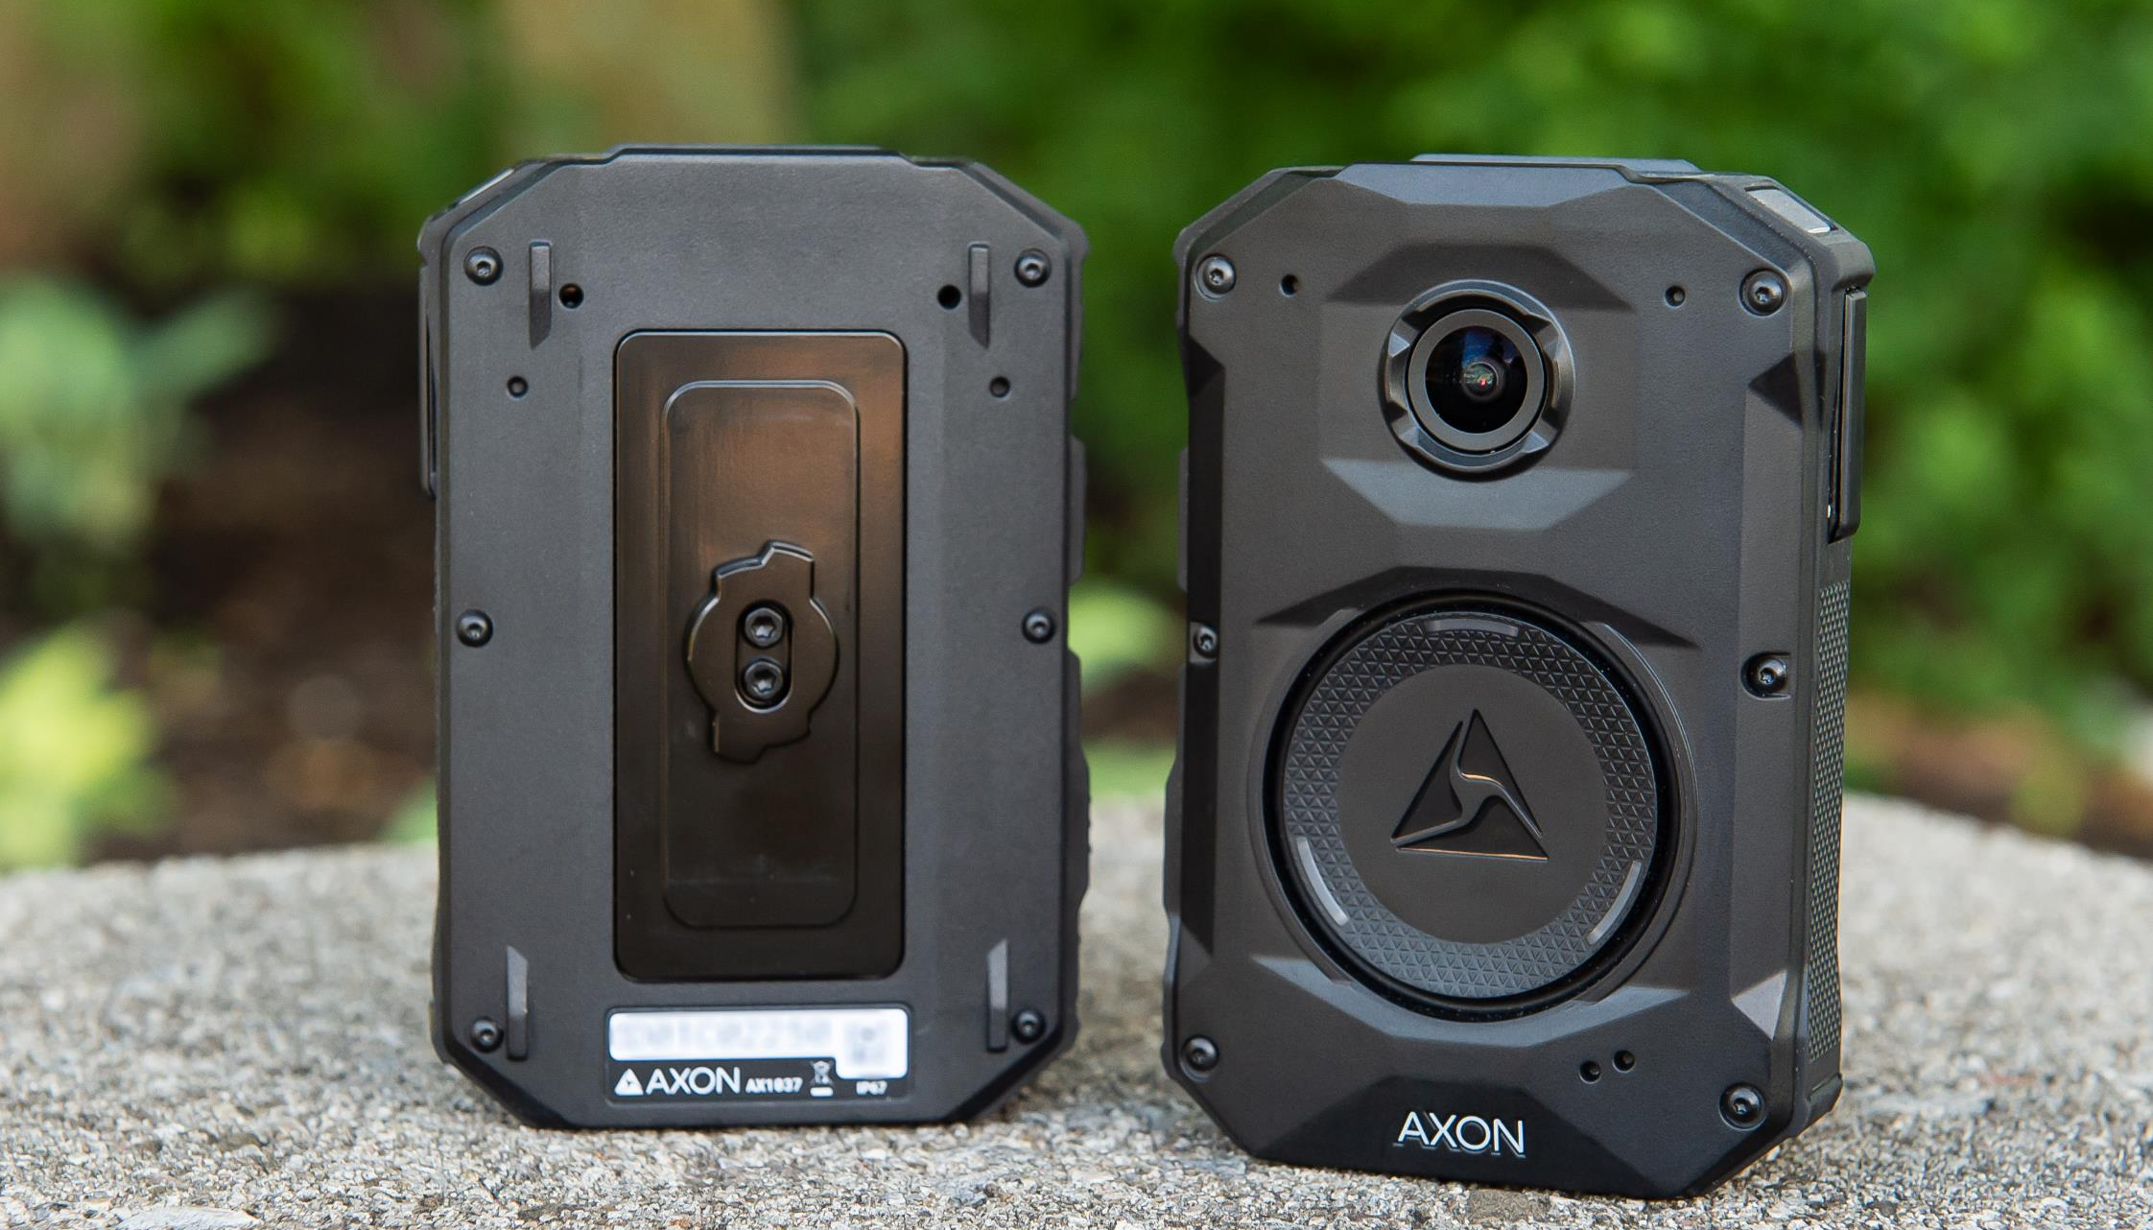
Videos are linked to an investigative file.
Original video recordings cannot be edited.
An officer cannot delete their own video evidence.
An officer can only access their own recorded videos. A valid rationale must be provided to obtain permission to access other video.
An audit log automatically tracks access to a video.
The retention period of a video depends on the type of incident captured on the video and is based on existing legislation (ranges from 30 days to 2 years or longer).
For disclosure purposes, video can be shared from the DEMS via a secure link
An officer can request and receive video footage or photos from members of the public via a secure link.
About the Digital Evidence
Management System

Slide 9
Community Request Feature
Axon Community Request is a capability that makes it easy for the RCMP to securely receive evidence submissions from the community and manage that media in the DEMS. Axon Community Request has two components:
Community Request – Individual Request (private): Allows officers to send out individual invites to witnesses directly from Axon Capture or DEMS
Community Request – Portal Request (public): Allows organizations to create public evidence submission portals where the public can submit evidence during both large-scale and smaller, day-to-day events. (Available in the Spring 2025)

Slide 10
Accessing Video
Through existing ATIP processes, members of the public may request a BWV in which they are captured. In this case, the personal information of others will be redacted.
The RCMP developed a process to guide Divisions in using BWV to facilitate the early resolution of a service issue where privacy can be mitigated.
Footage disclosure to the public would be made on an “exceptional” and case-by-case and could occur when the public interest clearly outweighs the invasion of privacy of an individual.
In consideration of a decision to disclose in the public interest, the following factors must be considered:
Expectations of the individual
Sensitivity of the information contained in the video
Probability of adverse consequences to an investigation or court proceedings as well as personal or physical injury or damage to the reputation of individuals or others.

Slide 11
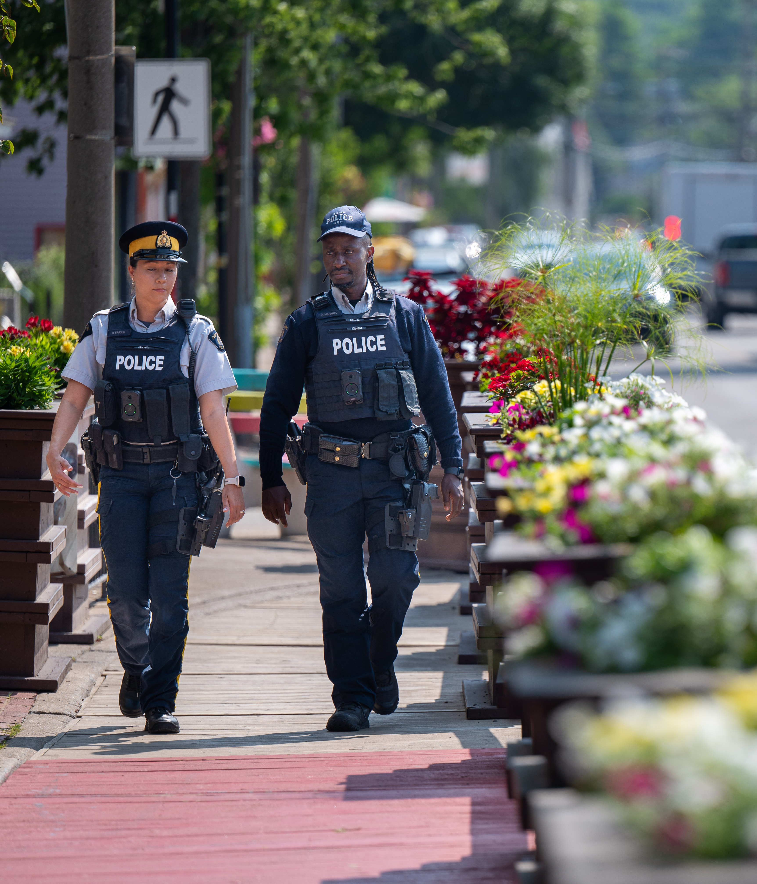
Feedback: What We Heard
Through survey feedback and stakeholder meetings, the RCMP heard concerns about:
Camera use and need for policy compliance
Privacy protection
Access & disclosure
Sensitivity when addressing gender-based violence issues (trauma-informed response)
Bandwidth in remote locations
Cost versus benefit
Input has been reflected, where possible, in our policy and in our implementation approach.

Slide 12
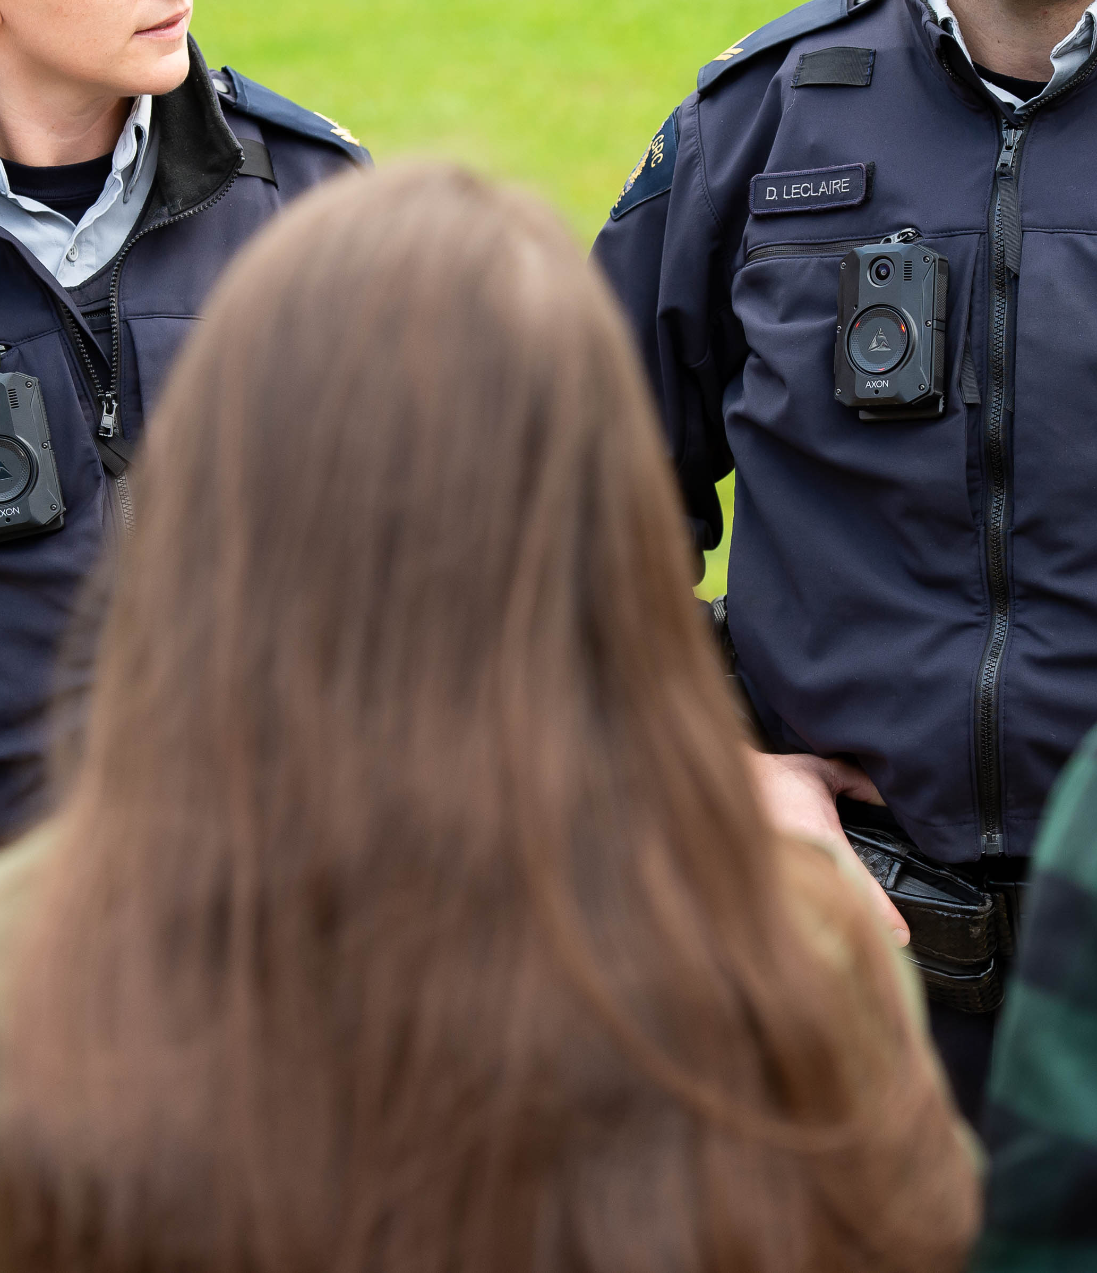
Feedback: What We Heard
Community survey responses indicate that respondents perceive that BWCs will:
Help RCMP officers be more transparent (91.5%)
Help increase RCMP officers’ accountability (91.2%)
Increase trust in RCMP officers (84.3%)
Make them feel safer when interacting with RCMP officers (78.9%)
Increase public safety (78.6%)
Improve the relationship between RCMP officers and their community (79.2%)

Slide 13
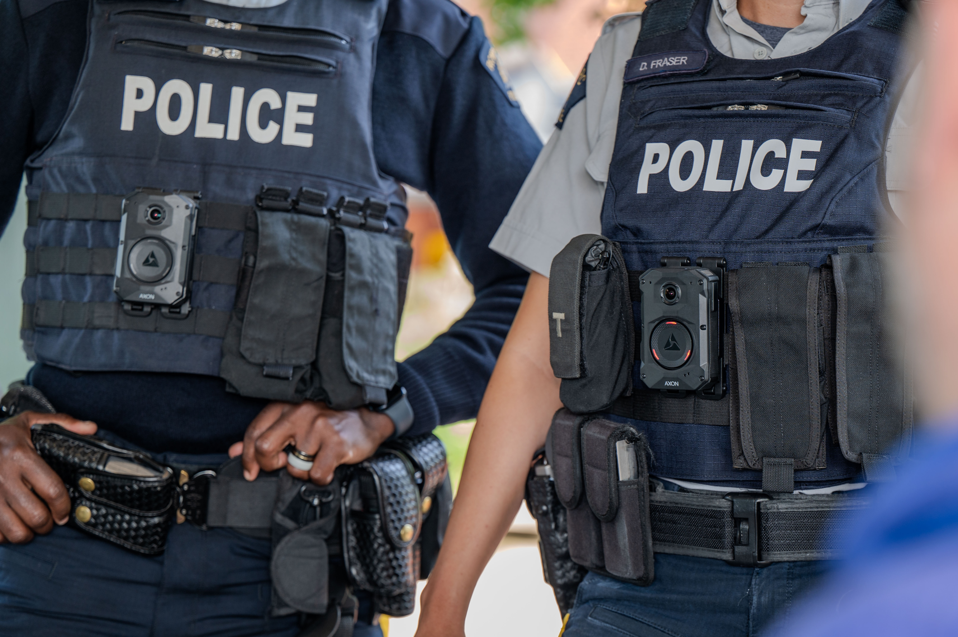
Learn More:
Web:
Body-worn cameras | Royal Canadian Mounted Police (rcmp.ca)
Email:
BWC_Consultations_CVC@rcmp-grc.gc.ca
To request a recording (ATIP):
https://www.rcmp-grc.gc.ca/en/access-information-and-privacy
RCMP Public awareness video:
ENG: https://youtu.be/G670cilb0AA
FR: https://youtu.be/f0kWohbC6K4
Have your say. Take the community survey:
Survey: The RCMP's use of body-worn cameras in my community | Royal Canadian Mounted Police
Questions?
Notes:
Did we capture your concerns?
Did we miss anything?
Is there anything you want to know more about?

